Slide 1
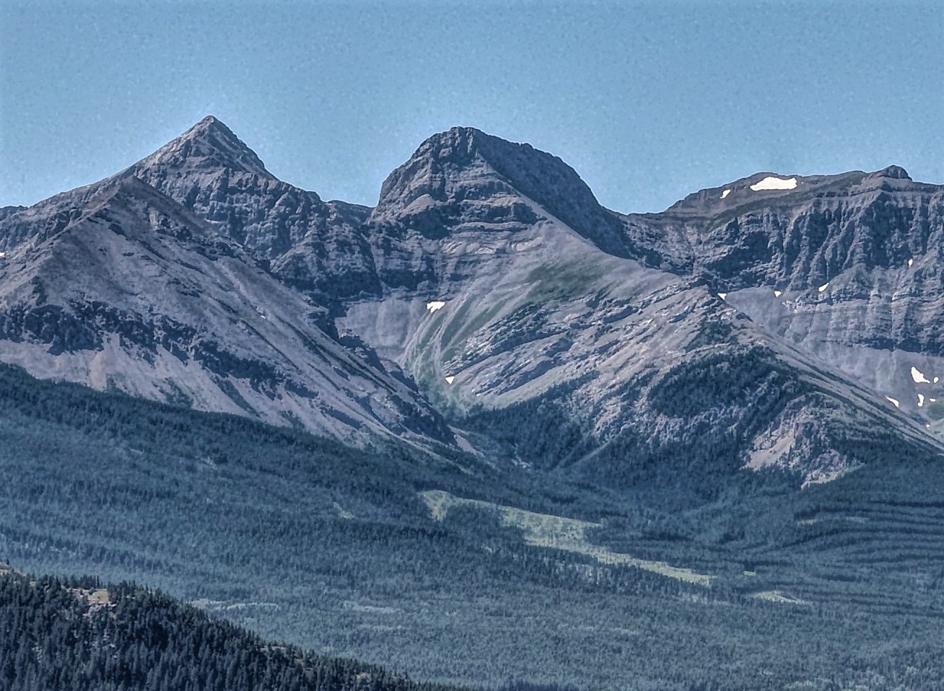
Big Mountain -
Profit Modeling

Slide 2
Problem Statement
Q: What action plan of increasing ticket prices, cutting costs, or capital investments can Big Mountain Resort take to boost revenue sufficient to cover the $1.54 million increase in operating cost and achieve an 8 percent profit by the end of this season?

Slide 3
Key Findings
Most Important Features most for Ticket Price
# of runs
Fast Quads
Snow Acres
Resort/competitor density
Good News
Our data analysis supports that Big Mountain Resort offers an above-market value per ticket!

Slide 4
Recommendation
Increase Ticket Price to drive Revenue
Suggested price: $95.87
Cut Operating Costs
Close 1 run to reduce costs at no loss to revenue

Slide 5
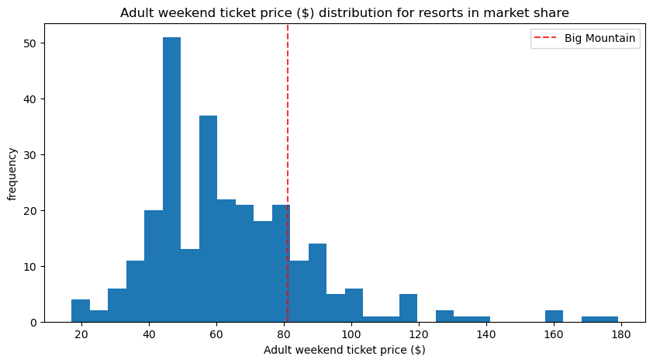
Current Ticket Price vs Competition
Big Mountain sits within the upper-mid range of ticket prices
How does the value of your facilities compare to this? See on the next slide

Slide 6
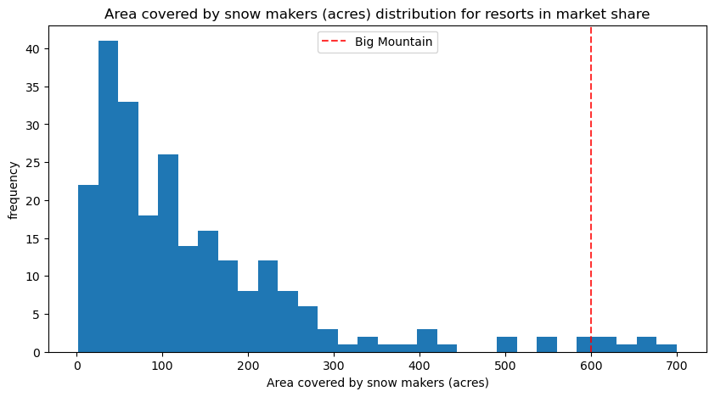
Snow Making Acres vs the Competition
Snow making acres is one of the top features for ski resort customers
BM (shown as red line) blows away the vast majority of competition

Slide 7
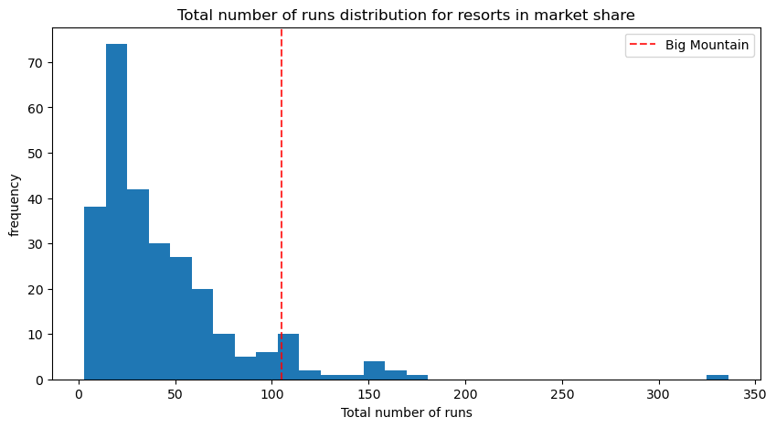
# of Runs vs the Competition
BM is near the top again with Snow making acres

Slide 8
Business Scenarios - Our Models in Action
Scenario
Permanently closing down up to 10 of the least used runs.
Result
Close 1 run - Makes no difference in revenue
Close 2 runs - successive reduction in revenue predicted
Close 3 runs - successive reduction in revenue predicted
Close 4 or 5 runs - revenue loss predicted to equal that of closing 3
Close 6 or more runs - steep revenue loss (not recommended)
Increase the vertical drop by adding a run to a point 150 feet lower down but requiring the installation of an additional chair lift to bring skiers back up, without additional snow making coverage
Result - supports ticket price of $8.61 & revenue of $15,065,471
Same as number 2, but adding 2 acres of snow making cover
Result - supports ticket price of $9.90 & revenue of $17,322,717
Increase the longest run by 0.2 mile to boast 3.5 miles length, requiring an additional snow making coverage of 4 acres
Result - does not support change in ticket price or revenue

Slide 9
Summary & Conclusion
Highlighted most important resort features
Demonstrated Big Mountain’s high value compared to competitors
Ran 4 business scenarios using our model to assess business performance of each
Suggested new ticket price $95.87

